Slide 1
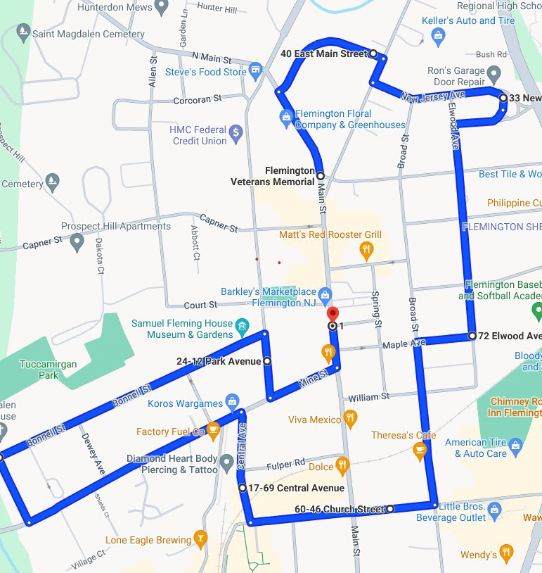
3
2
4
5
1
6
16
7
15
8
14
12
13
11
10
9
Turkey Trot 2023 Route

