Slide 1
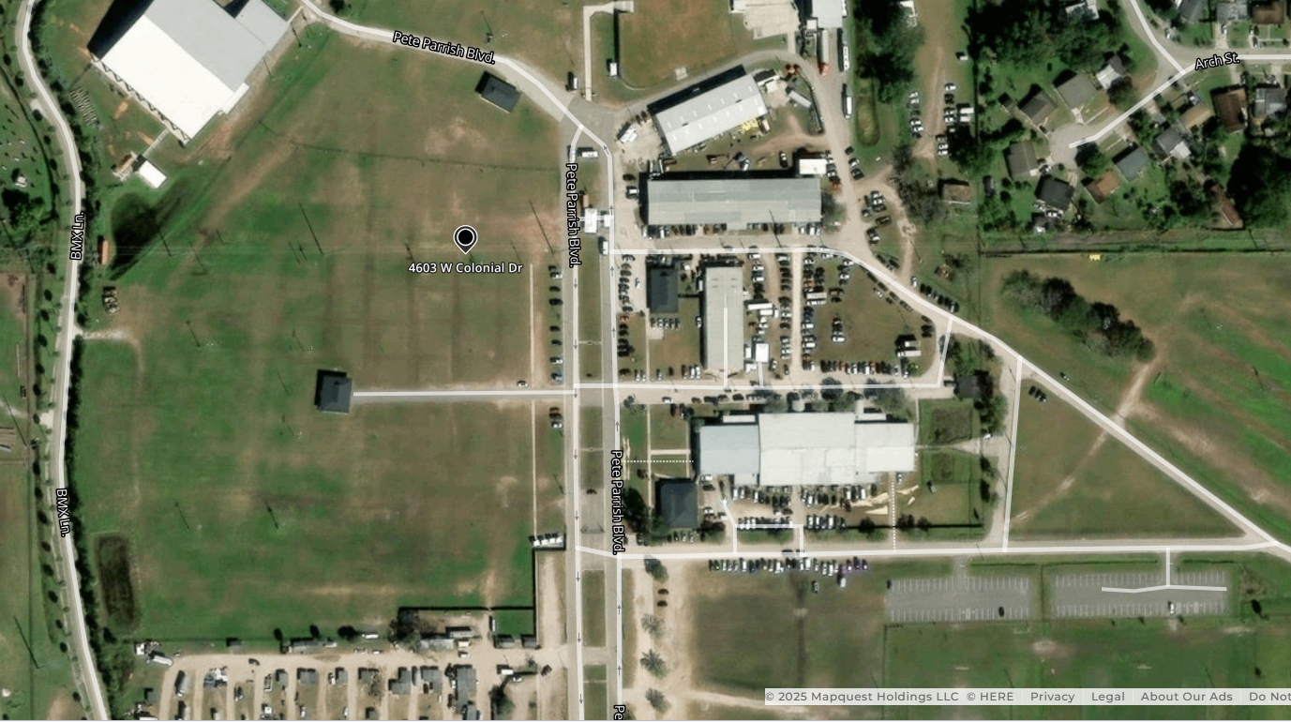
BATHROOM
TVARC
MAIN
GATE
---------------PARKING----------------

