Slide 1
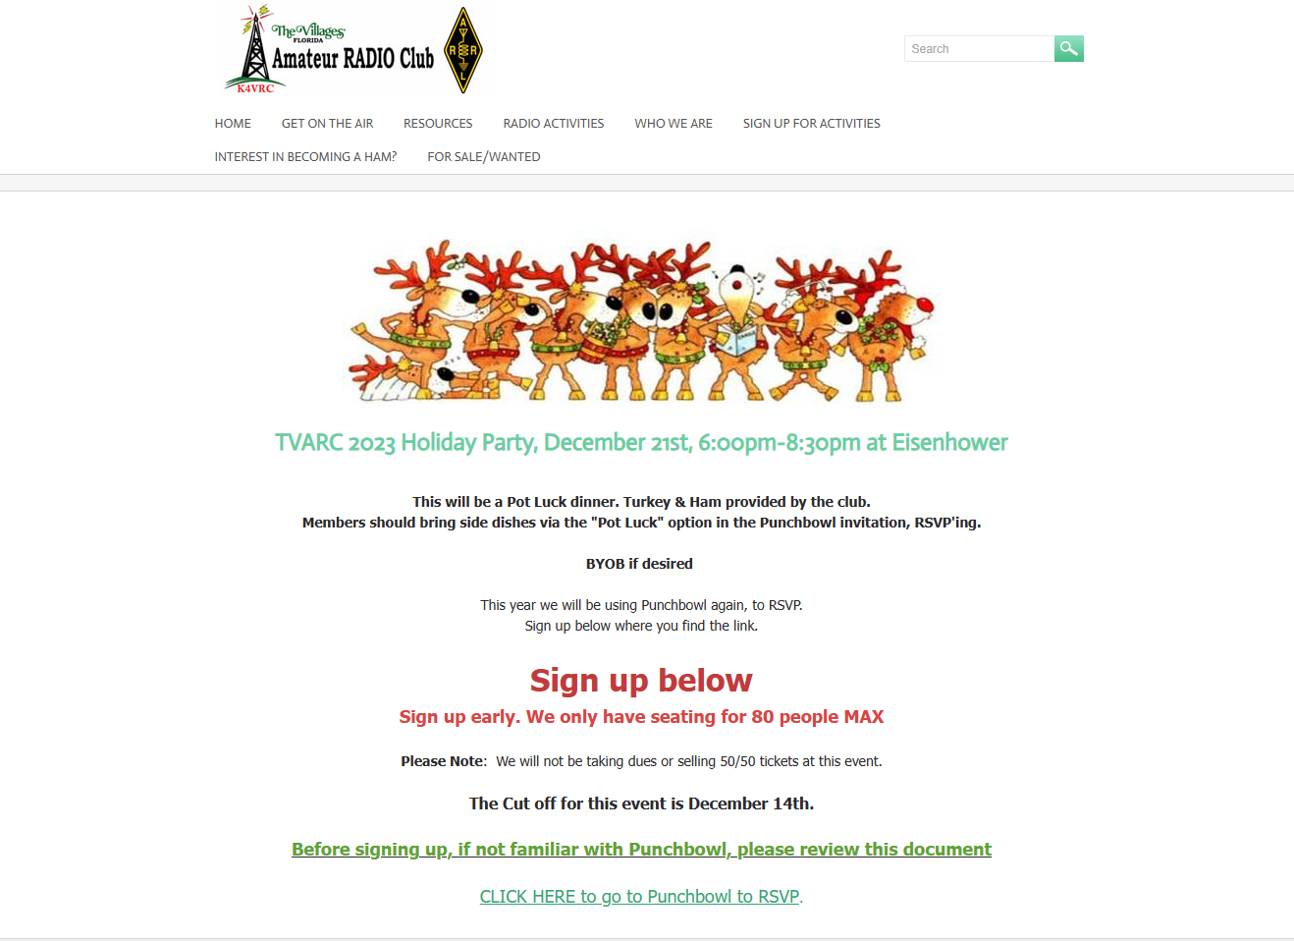
HOLIDAY PARTY SIGNUP VIA PUNCHBOWL

Slide 2
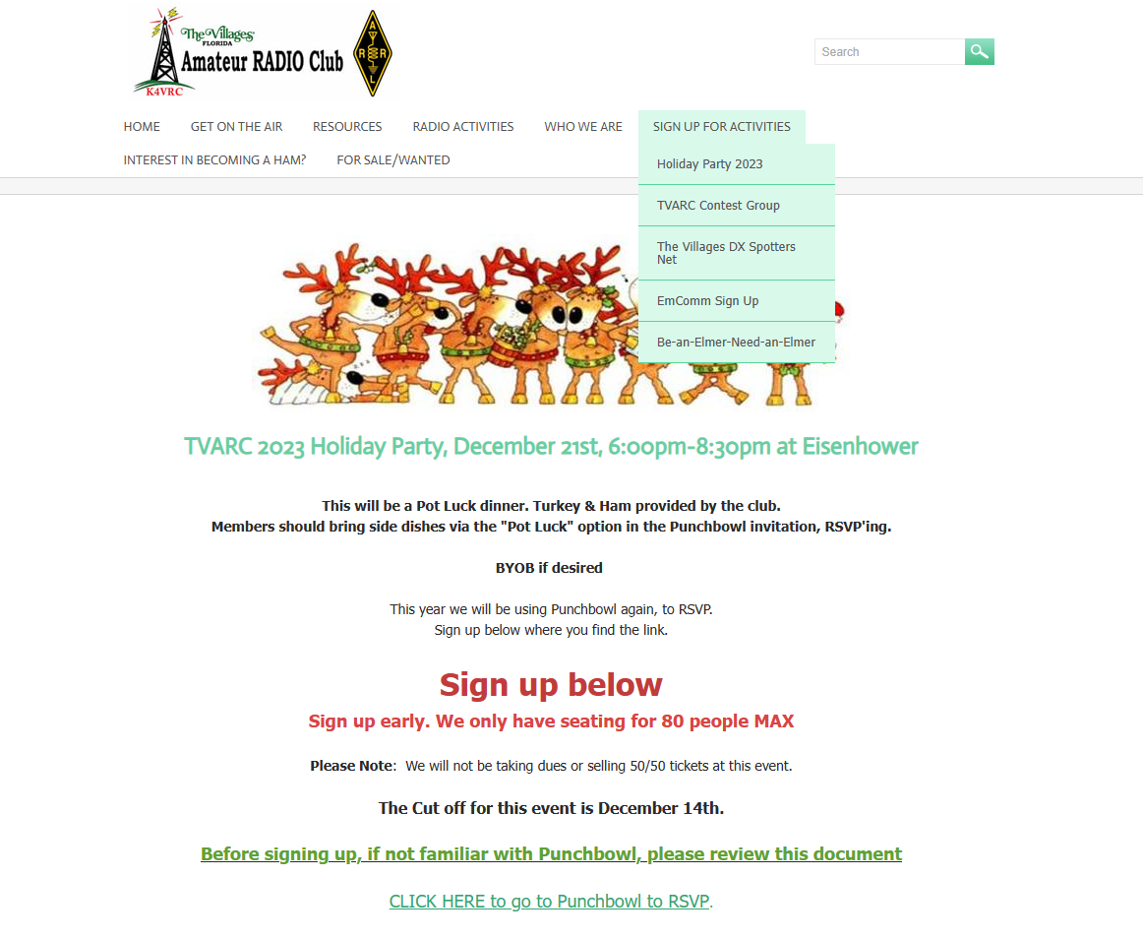

Slide 3
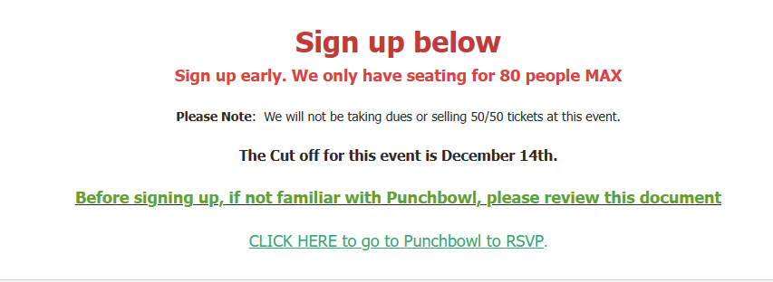
HOLIDAY PARTY SIGNUP VIA PUNCHBOWL

Slide 4
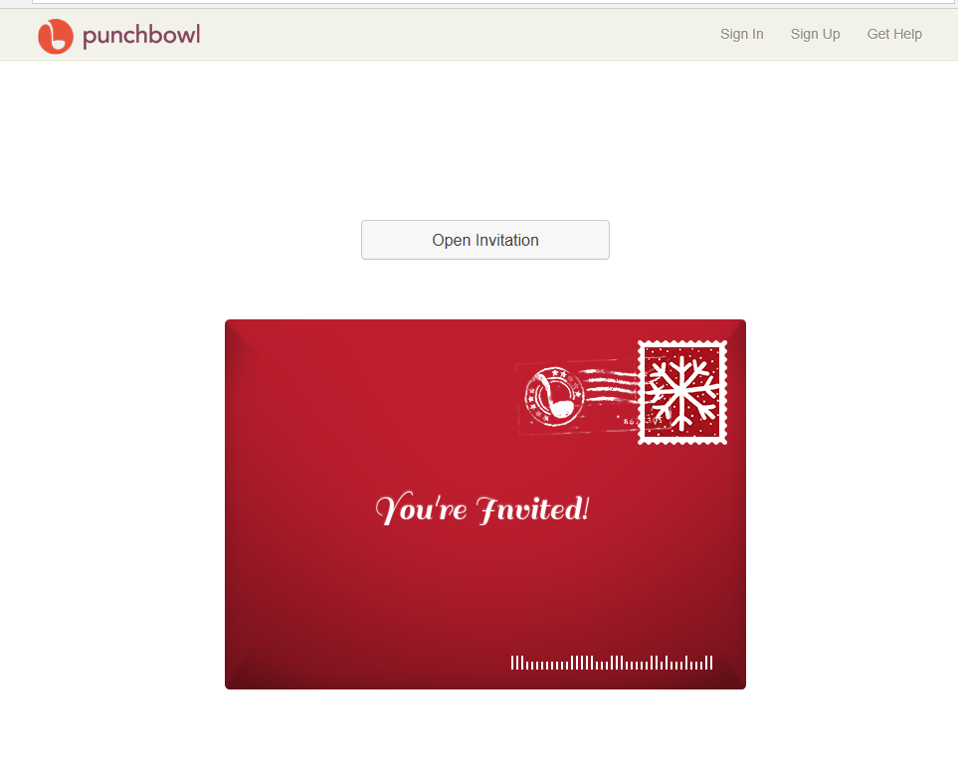

Slide 5
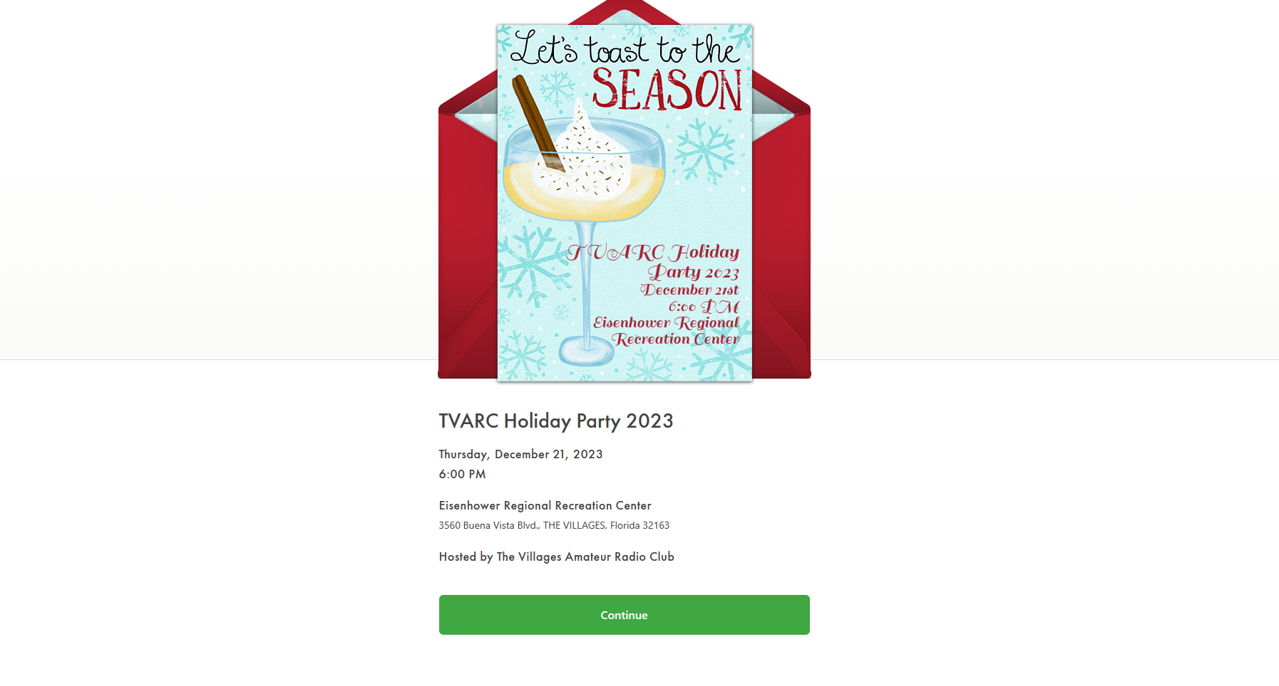

Slide 6
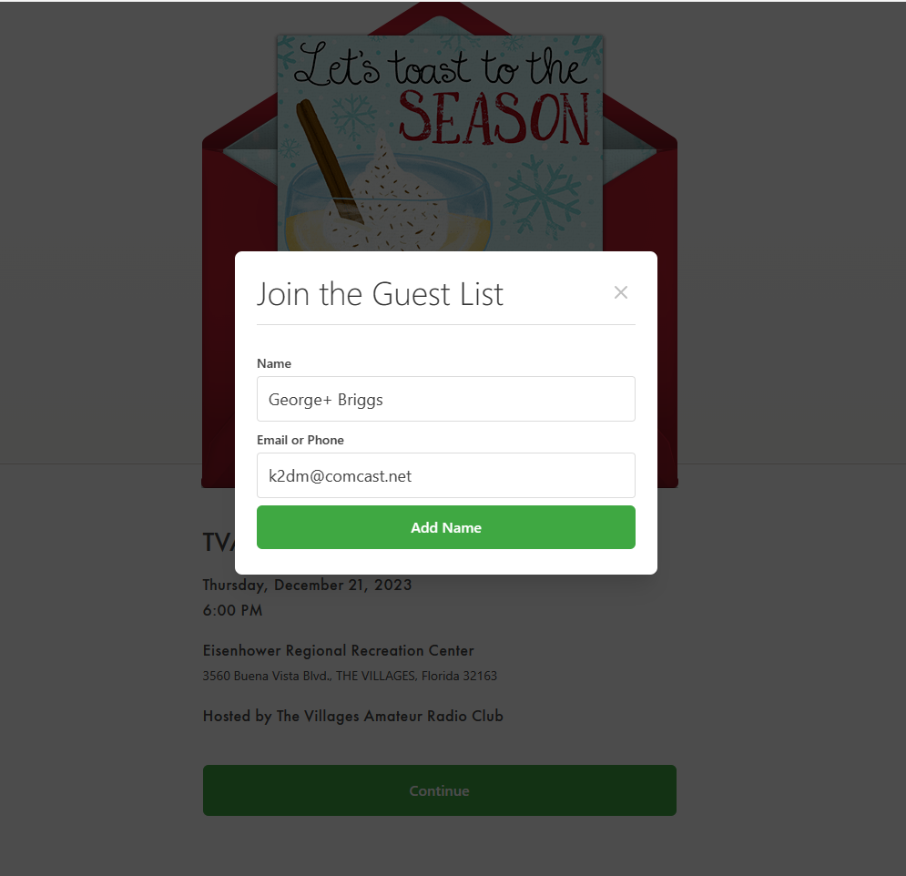

Slide 7
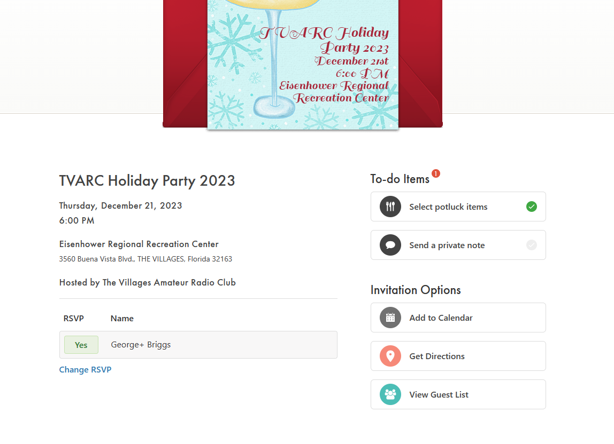

Slide 8
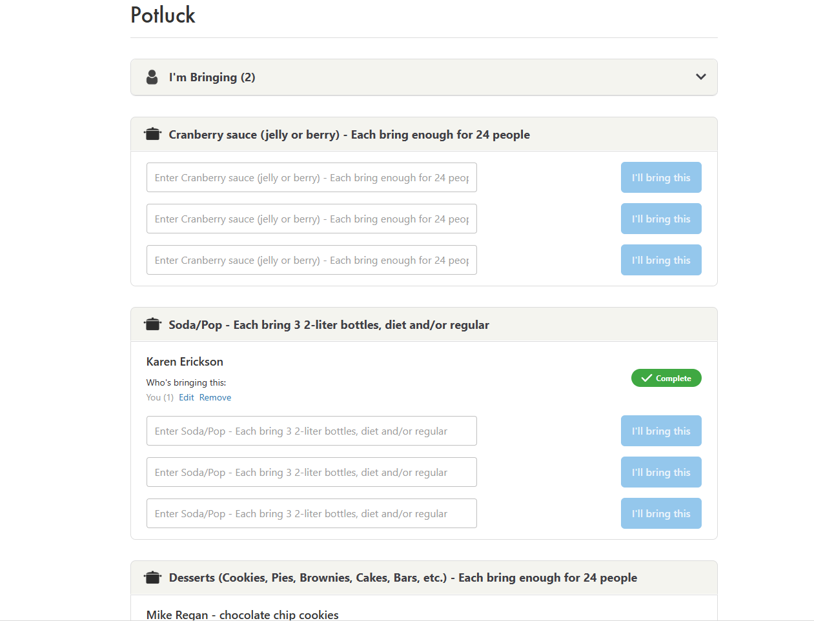
Enter your name.
Then click “I’ll bring this.”

Slide 9
POTLUCK CATEGORIES
Dressing / stuffing (6, each bring enough for 15)
Soda / pop (4, each bring 3 2-liter bottles)
Vegetables (green beans, corn, etc.) (6, each bring enough for 15)
Potatoes (mashed with gravy, sweet, scalloped, au gratin, etc.) (6, each bring enough for 15)
Desserts (cookies, pies, brownies, cakes, bars, etc.) (4, each bring enough for 24)
Salads (tossed, pasta, jello, broccoli, etc.) (6, each bring enough for 15)
Dinner rolls (4, each bring enough for 24)
Cranberry sauce (jelly or berry) (3, each bring enough for 24)

