Slide 1
RFI Guide Adding ferrite clamps

Slide 2
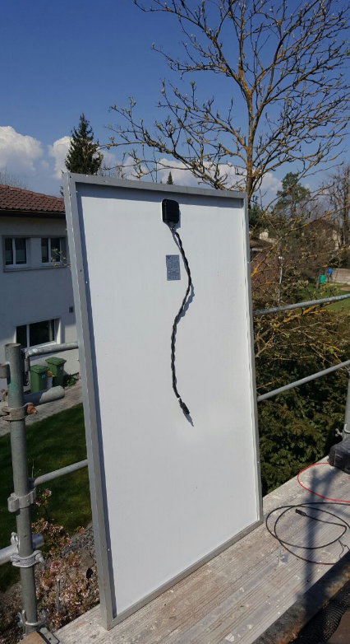
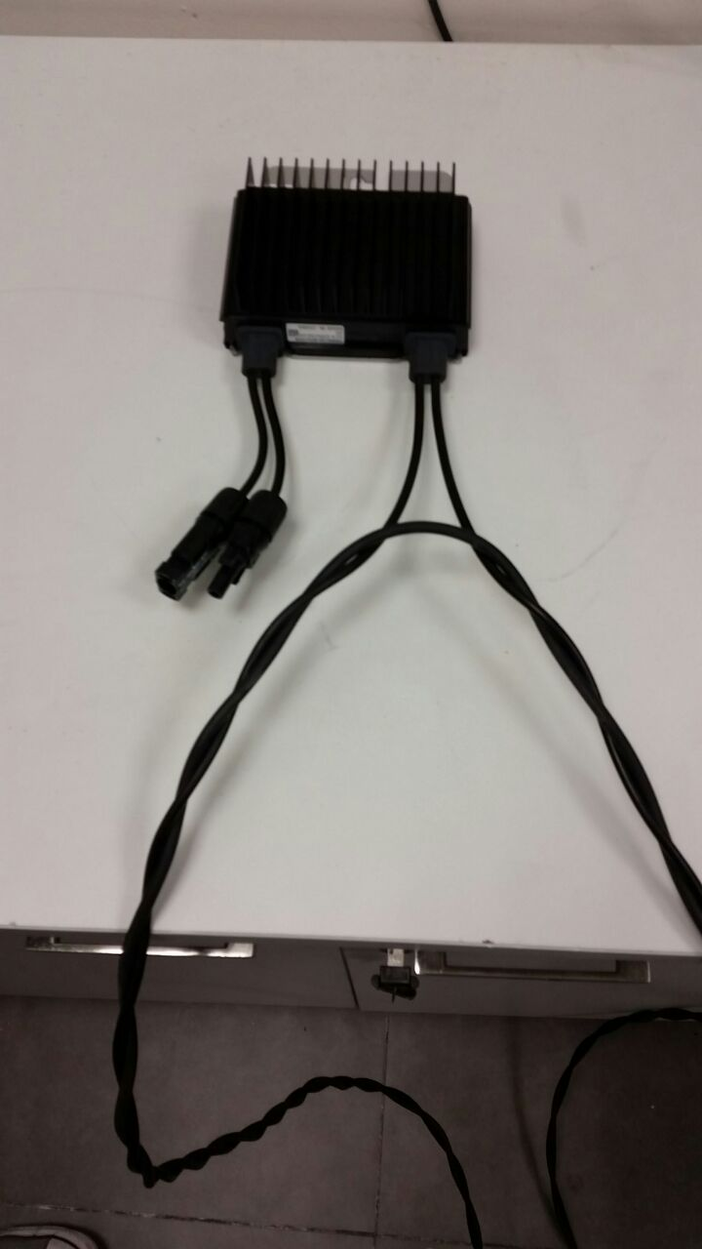
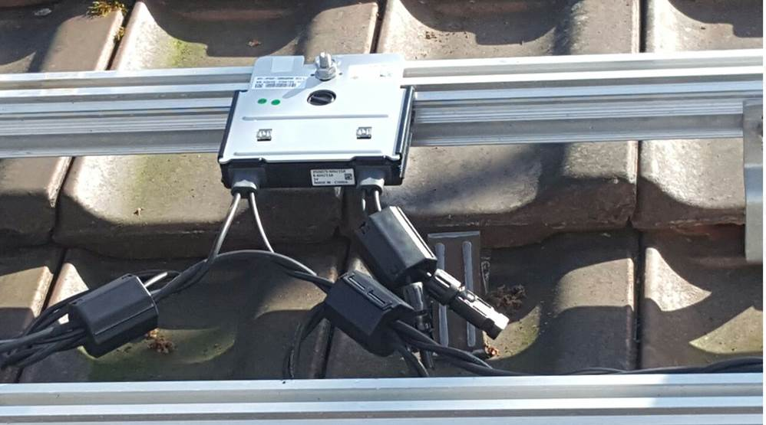
Step 1 – Twist cables
before adding the clamps cables need to be twisted the whole way to the inverter, including:
Home runs
Panel wires

Slide 3
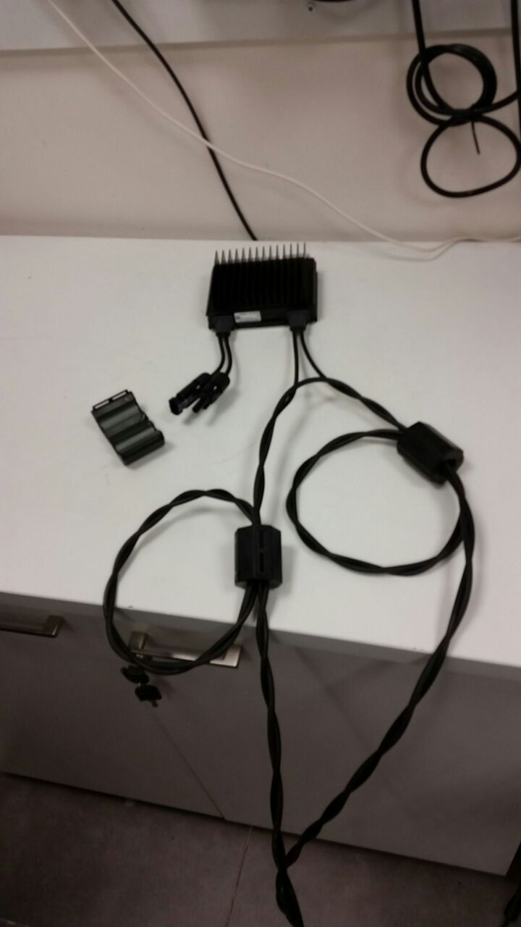
Step 2 – Add ferrite clamps
Create 3 loops with the twisted cables
Add 3x ferrites
1
2
3
3
To panel
1
2

Slide 4
Step 3 – Home run table
Add ferrites every 1 meter on the home run cable
Inv
Home run cable
1 m’

