Slide 1
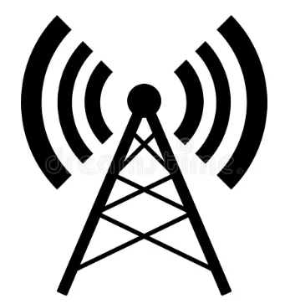
Antenna Basicss
A Simplified Perspective for
Hams and SWLs

Slide 2
Disclaimer
I am not an antenna expert!
Information presented here has been assembled from many different sources.

Slide 3
Why Understand Antennas?
The antenna is arguably the most important component in most radio systems.
Let’s use a sound system analogy to help reinforce this notion.
With a home audio system, you can have a $10,000 amplifier with small, cheap loudspeakers and it will sound awful.
Conversely, with a basic cheap audio amp and some really good speakers it can sound fabulous.
The speakers make all the difference; they contribute the most to what we hear.

Slide 4
Why Understand Antennas?
The same goes for an amateur radio station. Here we can have the nicest transceiver you can buy paired with a lousy antenna and we won’t hear much or be heard well.
But take a cheap radio with a good antenna and we can do wonders.
The antenna makes the most impact on a radio communications system.
Whether transmitting or receiving, a weak signal isn’t sometimes due to poor band conditions or lack of power, it’s caused by a bad antenna.

Slide 5
Definition
An antenna is simply defined as an arrangement of conductors used to radiate electromagnetic energy into space or, conversely, collect it from space.
Sounds simple, right? In reality, functional antennas are a bit more complicated. There are many factors to consider in practical antenna design & installation.

Slide 6
Definition
It may also be helpful to think of an antenna as a transducer which converts alternating current (AC) into radio waves, and, conversely, radio waves into AC.
You may be unfamiliar with the word transducer – it’s a device which changes one form of energy into another.
We are all familiar with: Speakers, microphones, temperature and pressure sensors, room lighting of all sorts, and indicators. They are all transducers.
We control the electrical side of things in our radios and the antenna converts that AC into useful radio waves, and vice-versa.

Slide 7
Common Characteristics
Antennas come in a myriad of sizes, shapes and configurations.
These vary greatly based on the nature of the application (mainly frequency and performance).
Regardless of these differences, all antennas share three common characteristics:
          Reciprocity
          Directivity & Gain
          Polarization

Slide 8
Reciprocity
Reciprocity means it works both ways.
The electro-magnetic characteristics of an antenna make it work equally well for transmitting and receiving.
This means that for both transmission and reception, antennas are equally directive, have equal gain and bandwidth, and have the same polarity.

Slide 9
Directivity & Gain
Directivity is an antenna’s ability to focus the energy to - or from - one or more directions.
All practical antennas have some degree of directivity, some slightly directive (verticals), some semi-directional (dipole), and others very directional (beam).

Slide 10
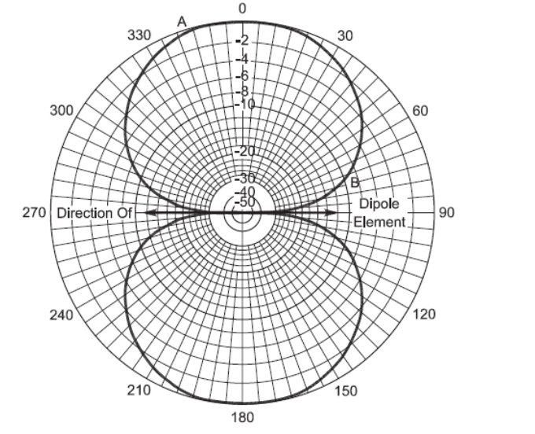
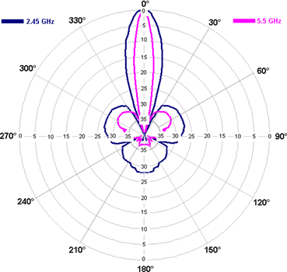
Directivity & Gain
Antenna radiation Patterns
Yagi
Azimuth
Dipole
Azimuth
Yagi
Elevation
Parabolic (Dish) Azimuth

Slide 11
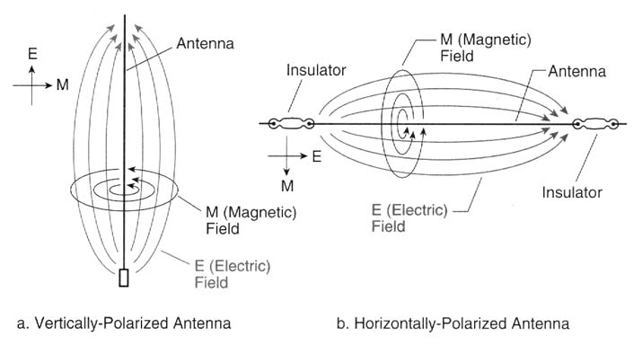
Polarization
Antenna polarization is determined by the orientation of the electric field with respect to the earth.

Slide 12
Polarization
For line-of-sight communications in the VHF and UHF spectrum, antenna polarization is important.
All repeater antennas and mobile antennas are (or should be) vertically polarized.
Handheld transceivers (HTs) work best when held with the antenna up and down. You would see about 3dB signal loss (half power) at a 45º tilt.
For short distances in open space polarization is a non-issue due to relative signal strength.

Slide 13
Polarization
At lower frequencies in the HF spectrum antenna orientation is less important because ionospheric propagation randomizes polarization.
This blended E-field orientation is sometimes referred to as elliptical polarization.
As a result, you can use either vertical or horizontal antennas on HF bands.

Slide 14
Other Factors
Yet there are other factors important to antenna theory.
Primary among these are:
Impedance
Capacitance

Slide 15
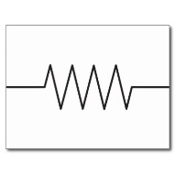
Impedance
Can be thought of as “AC Resistance”
All antennas have impedance at a given frequency.
Antenna impedance varies with conductor arrangement, signal frequency, height above ground, conductor diameter, nearby objects, and connecting wires (feedline), among other things.
For maximum power transfer of a source to a load, the impedance of the source, load and transmission line must be the same (matched).
Signal Source
~
Load
Transmission Line

Slide 16
Impedance
In an antenna system these three impedances are matched as closely as possible over a specified range of frequencies.
When there is an impedance mismatch, some of the signal is reflected back to the source. Of course, the impedance there doesn’t match so part of the reflected signal is reflected back again.
And so on: back and forth until the signal is attenuated into oblivion, losing part of its energy all the way.

Slide 17
Impedance
Matching antenna impedance seems obvious when transmitting, since you want all of your transmitter power to be radiated from the antenna.
But it also works in reverse. When receiving, signal strength is also maximized by properly matched impedances.

Slide 18
Impedance
A common way for hams to quantify impedance matching is with the term Standing Wave Ratio (SWR).
SWR is a generalized measurement of how well matched the radio is to the antenna and feedline.
SWR is quite a topic in and of itself, because the antenna is only one contributor to SWR. We’ll take a simple look at SWR in a moment.

Slide 19
Capacitance
Capacitance is a measure of how easily an object can store electric charge.
The capacitance of an object is the ratio of the amount of charge to the potential difference between conductors.
The capacitance of a capacitor is the ratio of the maximum charge that can be stored to the applied voltage across its plates.
The use of a capacitor can have a big impact on the physical size of an antenna. For example, a capacitance "top hat" on a Planar Inverted F antenna can reduce the antenna size by 30% or more.

Slide 20
RX vs TX
The antenna’s impedance determines how much incident RF power will be converted into current flow in the antenna and how much will be reflected back off it.
This is a much more significant issue if the antenna is being used to transmit RF power rather than receive it. For the case of a transmitting antenna, the antenna designer has to get an impedance match between the antenna, the feed line, and the transmitter at the frequency being produced by the transmitter.
A good match may require the addition of small amounts of capacitance or inductance to the antenna structure in order to tune it…(Demo)

Slide 21
Real-World Antennas
All this theoretical study of antennas is fine and necessary but in the real world a practical antenna is imperfect.
A real antenna system is always a compromise or tradeoff between two or more competing interests:
  Bands/Frequencies
  Directivity & Gain
  Bandwidth
  Space Available
  Practical Height
  Cost
  Stealthiness/Visibility
  Spousal Approval…

Slide 22
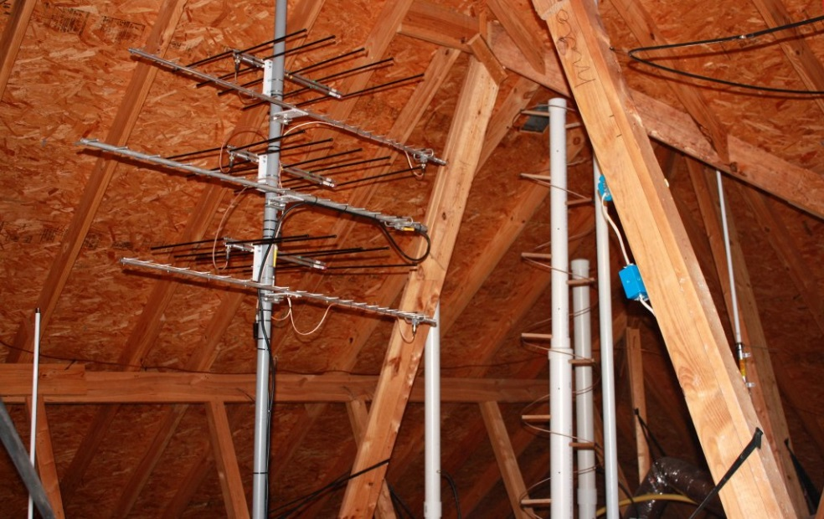
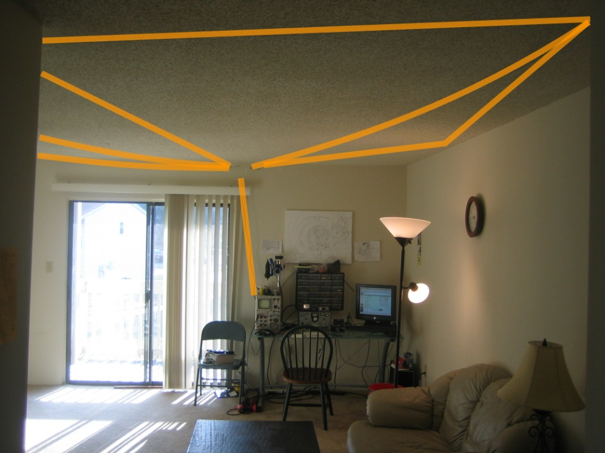
Real-World Antennas
Many hams live in urban or suburban areas with little or no space to install antennas, or have restrictions on what is allowed.

Slide 23
Types & Configurations
Let’s look at some common antenna types and configurations.
We’re going to present only the basics today.
The advantages, disadvantages and other details of these types will be covered in a separate presentation.

Slide 24
Types & Configurations
Standard Dipole
Typically half-wave center-fed antenna with two quarter-wave symmetrical elements.
Resonant at one frequency (single-band).
Three common orientations: horizontal, vertical, and sloping.
Sloper
~
~
~
Vertical
Horizontal

Slide 25
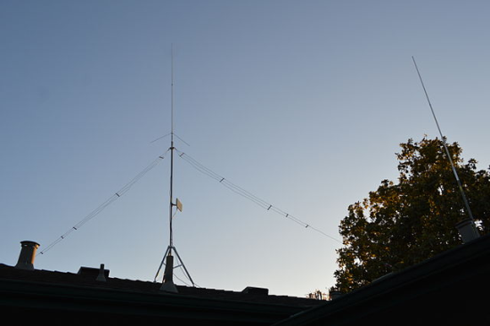
Types & Configurations
Inverted Vee
Common variant to the standard 1/2-wave dipole.
The name derives from the orientation of the dipole elements that are supported in the middle and angled down.
This dipole occupies less horizontal space and requires only a single center support, which makes it popular for field use on HF bands.
Inverted Vee
~

Slide 26
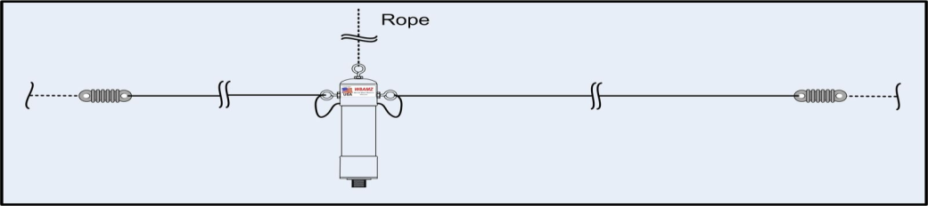
Types & Configurations
OCF Dipole
Half-wave antenna with asymmetrical elements.
Feed point is off-center (OCF=off-center fed). Also known as a Windom antenna.
Proper design permits multi-band operation.
Horizontal, sloping, or inverted vee orientation.
~
OCF

Slide 27
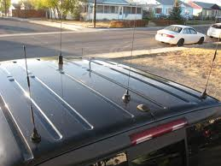
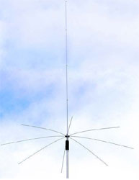
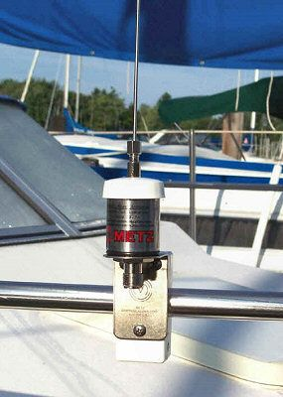
Types & Configurations
Vertical Monopole
Instead the vertical monopole replaces the lower element by the earth (ground) or a substitute called a counterpoise or ground plane.
Vertical Monopole
~
Ground Plane or Counterpoise

Slide 28
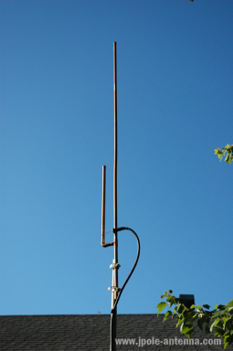
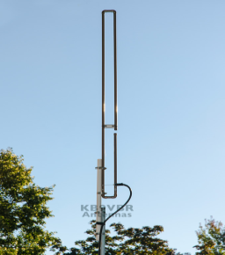
Types & Configurations
J-Pole
Half-wave (λ/2) end-fed antenna also known as the Zepp (originally developed for use on airships with the antenna trailing behind).
Features a λ/4 parallel tuning stub (for impedance matching) that forms a J-shape.
Slim-Jim version folds over longer element for greater gain.
J-pole
~
VHF J-pole
Slim-Jim Variant

Slide 29
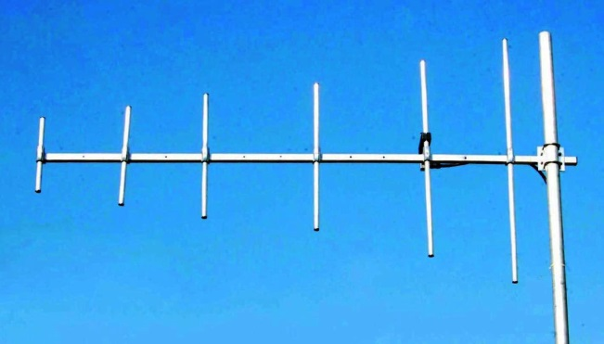
Types & Configurations
Yagi
Directional (beam) half-wave center-fed antenna with two quarter-wave symmetrical elements.
Essentially a dipole with extra elements to provide directivity. Officially termed Yagi-Uda (inventors).
More commonly oriented horizontally but may be vertical for local VHF/UHF use.
6-Element Vertical Yagi
Typical 3-Element Yagi
~

Slide 30
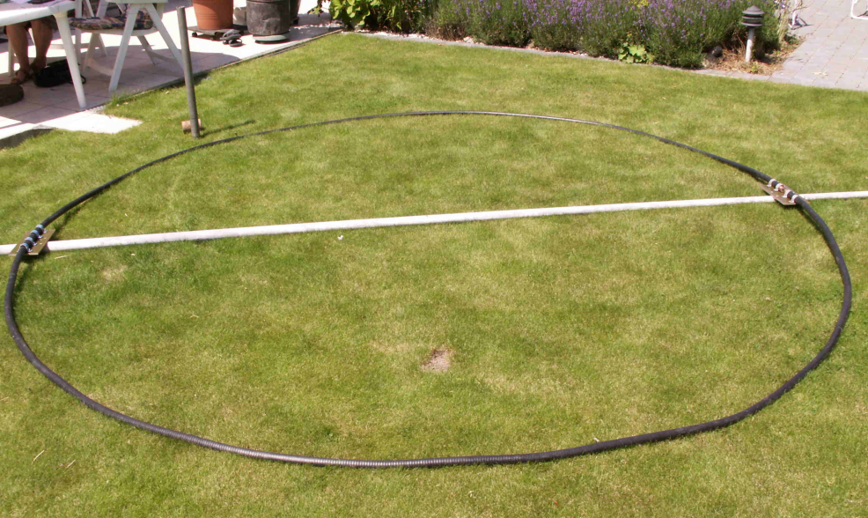
Types & Configurations
Loops
Loops are generally grouped into two classes.

Slide 31
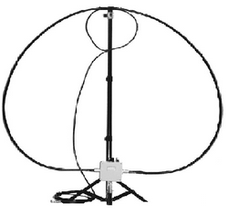
Types & Configurations
Small Loop
The small (AKA magnetic) loop is a fractional wavelength antenna with poor efficiency.
This magnetic loop has superior directional qualities and is often used in radio direction finding. Small loops also have excellent electrical noise immunity.
Matching requires fine tuning with a large variable capacitor. For this reason it is not often a ham’s primary HF antenna. However, it is well-suited for low-power (QRP) portable use.

Slide 32
Types & Configurations
Large Loop
The large (AKA resonant) loop is simply a single full wavelength element, λ in circumference.
The loop shape is generally round but it does not have to be circular. It can be oval, hexagonal, square or even triangular. Acute angles should be avoided.
Round Loop
Ovoid Loop
Hex Loop
Square Loop
~
~
~
~

Slide 33
Types & Configurations
Large Loop
Due to the long lengths required for full-wave antennas, resonant loops need a lot of space.
For the 80m band, the loop would be around 270ft long. On 40m the circumference would be 140ft. On 20m you need a 70ft loop.
Although multiple turns may be used to reduce the diameter, performance improves with greater loop area. Lower-frequency HF band loops are often relatively low to the ground and horizontally oriented.

Slide 34
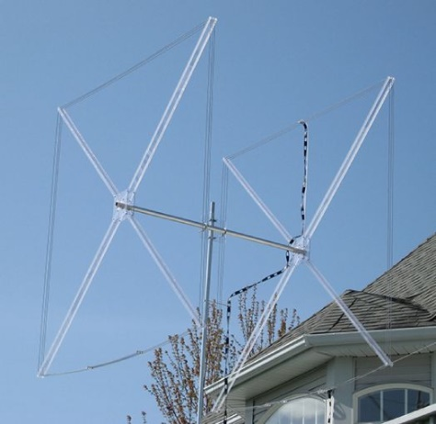
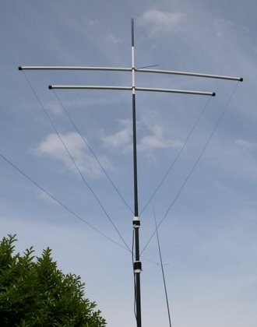
Types & Configurations
Quads & Deltas
Directional (beam) antennas derived from the loop.
Usually two-element antennas with parasitic reflector slightly longer than λ.
Gain comparable to a 3-element Yagi.
Polarization depends on orientation of feedpoint.
Quad
~
~
Delta

Slide 35
Types & Configurations
VHF/UHF Mobile
Vertical monopole with the vehicle body/chassis acting as the ground plane (counterpoise).
Nominally λ/4 whip for general omni-directional radiation pattern.
5/8-wave mobile antennas are more popular because they have radiation lobes closer to horizontal with relative gain over 1/4-wave.
~
Vertical Monopole

Slide 36
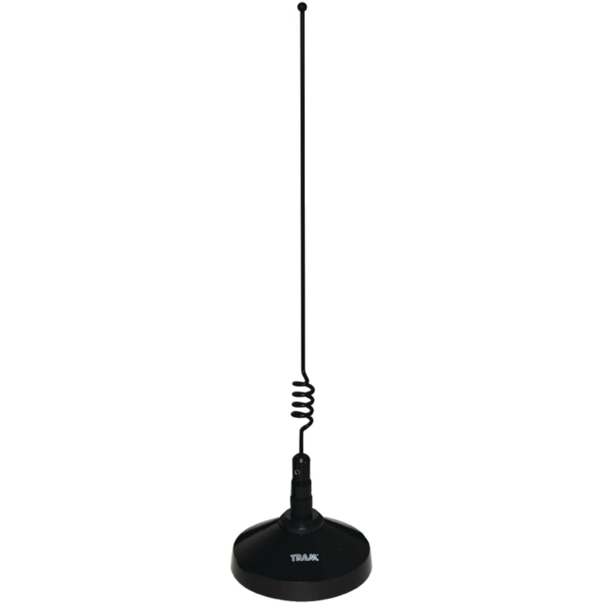
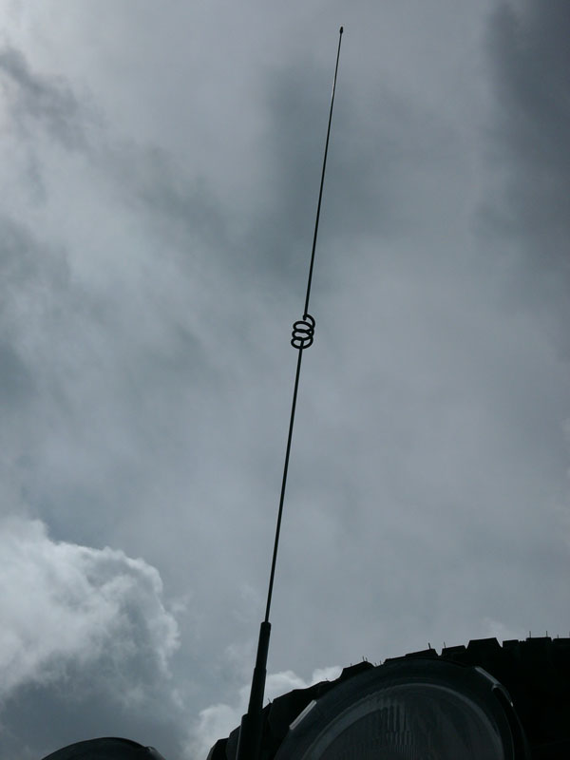
Types & Configurations
VHF/UHF Mobile
With the 5/8-wave whip an inductor (loading coil) is added for impedance matching and is usually located in the middle but sometimes at the base.

Slide 37
Types & Configurations
VHF/UHF Mobile
Most VHF mobile antennas work well on UHF so are often called dual-band antennas.
This is unique to the 2m and 70cm amateur bands where the UHF band is 3x the frequency of the VHF band.
Antennas are resonant on odd multiples of the wavelength. 70cm (435MHz) is conveniently close to the third harmonic of 2m (146MHz).
Radiation patterns are a little different but a 2m antenna generally works for 70cm.

Slide 38
Other Types & Configurations
There are many other antennas out there with some really interesting names: Bazooka, Discone, Parabolic, Log-Periodic, Beverage, Nord, Isotropic, Helical, Cloverleaf, Bowtie, and others.
We could spend hours discussing antenna types but have presented the most common ones that an ordinary ham is likely to see or use.

Slide 39
Antenna Safety
RF exposure by contact means: Do not touch the antenna elements when transmitting. It also means never install an antenna where people or animals might contact it.
RF exposure by radiation must also be considered. Be aware of power levels and frequencies where this becomes a safety concern. Understand Maximum Permissible Exposure (MPE) and the FCC regulations associated with it.

Slide 40
THANK YOU!

