Slide 1
The Victorian Internet
Yes, Steampunk, there was such a thing!
Dom Mazoch N5TCB
January 2020

Slide 2
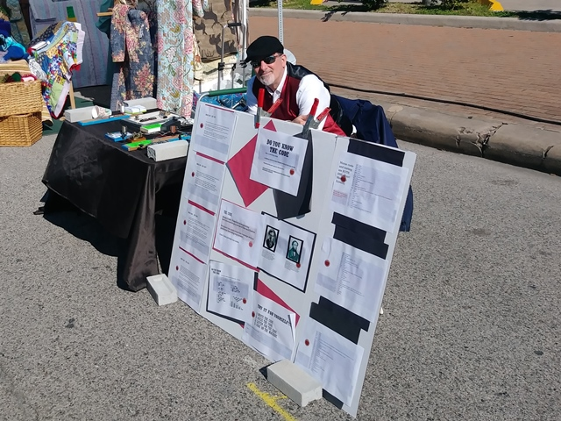
Once upon a time, before Al Gore….

Slide 3
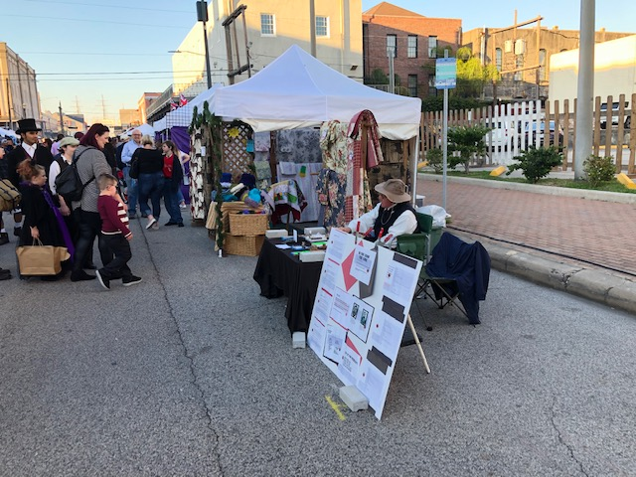
The Victorian Era has its form of electronic communication……

Slide 4
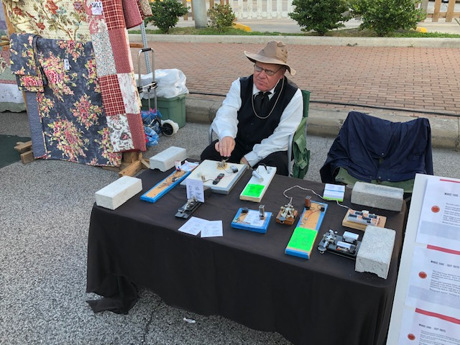
Telegraphy!

Slide 5
How did this project get started?
As with anything else, this came about from several fronts:
Home.
Galveston Historical Foundation(GHF), and its Dickens on the Strand(DOTS).
Oak Forest Amateur Radio Club(OFARC).

Slide 6
Home
One day I was at home order something on the internet. My 90 year old Mom was asking me what I was doing?
I said I was ordering something on the internet.
She said she did not understand.
I said the internet was to my generation what Western Union was for hers.
In her case, if you wanted to order something quickly, you would go to the WU office at the Southern Pacific Station in Schulenburg, and send a telegram and wire money, to say, Sears.

Slide 7
Home
She got the generational connection. But she never got into computers.
But she always supported period demos……..
I could not really get anything done about this, because I had to watch her.
Things changed on 09.06.2019 she died.
She always said that if I was playing with Lionels or radio, I could not be getting into trouble…..

Slide 8
GHF
GHF is the organization which helps preserve the history of the Island, both as story, culture, structures, and the Tall Ship ELISSA.
It has various historical fundraisers a year.
The oldest of these is DOTS
Website: www.galvestonhistory.org
Disclaimer: N5TCB is a member

Slide 9
DOTS
Downtown Galveston was at one time was called the “Wall Street of the Southwest”.
Much of the goods shipped to or from the port in the 1800’s went to or from the United Kingdom.
London’s “Wall Street” was and is called “The Strand”.
Most of the streets in the older part of the Island, especially east of 25TH have two names. In some cases, THREE. 25th can also be called “Rosenberg”. Earlier it was known as “Bath”.

Slide 10
DOTS
Many financial organizations had buildings or offices along Ave B. So the street got the name it is known today: The Strand.
About 46 years ago, this historical area of Galveston was basically a shell. It was about to be torn down.
GHF came to the rescue. It began to have fundraising and awareness events along The Strand the first weekend of December. This started the beginnings of DOTS.
They also got some ideas from a like festival in the SFO Bay Area.

Slide 11
DOTS
I as a member, have always felt there should be more period demo events, and suggested to staff as much.
But I was tied down until this year…….
The three things which influenced tech advancement in the Dickens period was the increase use of iron, steam power, and telegraphy.

Slide 12
OFARC
Meanwhile, back north on the always under construction Gulf Freeway…..*
OFARC has had and is building upon getting the word out about Amateur Radio via Scouting and with the Houston Museum of Natural Science Sugarland.
I suggested at the August 2019 meeting that the club offer a short 8 hour WIRED CW demo on the Saturday of the 2019 DOTS.
Note WIRED. DOTS “period” is 1812 to 1870, the years of Charles Dickens life. Radio is not in this time frame.
(*)Construction dates: 1947-……..?

Slide 13
OFARC
I did some research, and except for some hams getting together to put N5E, the ELISSA on the air for Museum Ships Weekend(MSWE), there has been no ham contact between any formal Ham group and GHF.
My concept was to take some CW keyers and flashlight semaphores, give out some CW cheat sheets, let the people try their fist.
This was to be a history of STEM demo, not a ham demo. No radios except for handies and cells to promote communications to those who were coming.

Slide 14
OFARC
The concept was to have Ralph, KE5HDF ,come with his equipment, and N5TCB work the paperwork with GHF.
OFARC approved the project and told me to do what was needed to get GHF approval.
Timing was tight. Had to get things to the GHF offices by September 17.
The principle of this “first contact” was to “underpromise but overproduce”. Test the waters slowly and see what happens.

Slide 15
Manure happens!
As the event came close, some issues came up.
Ralph had some medical issues and had to bow out.
So Dom had to get the stuff from his house near BW8 and I-69S
In the days before the event, the person in charge of the booths got changed. The OFARC paperwork was lost. But the new person in charge, Jami Durham, saved the project. We have known each other for a long time within GHF. I showed her the keyers and other items, and told here what we wanted to do. She asked if we needed anything, and I said: No we are self contained. We were still good to go.

Slide 16
Place in DOTS
In the past few years there has been a place for children’s period events, and children played with period toys. There was also a live blacksmith demo.
This last year, they had placed the smiths, and those who had hand maid items in a location called Craftsman Skills Row. We were placed there.
I set up, with basic table, keyers, cheat sheets, and a poster. Berry, KG5IRR came and stayed the whole day. What happened surprised me…….

Slide 17
What dialect?
OK, what are the two dialects of Morse?
We kept the International version, the one we use today .

Slide 18
... --- … … --- … … --- … … --- … … --- … … --- …
My CW is non-existent. But I knew SOS. Started to key, and many adults knew that from the code. They slowed down or stopped. They came by and asked if we needed assistance? These were ADULTS. They said they learned it for work, Scouts or Camp Fire Girls. Some asked if CW was still needed to be a ham?
The idea behind the booth was not to promote directly ham radio. But if a person asked, we agreed to give that info. We said CW was still a mode to communicate, but one does not need it to pass the ham examinations.

Slide 19
The Demo
We also were telling people to learn SOS in CW in case of an emergency. Some people were found in the 911 disaster because they pounded SOS on pipes or concrete. Flashlights and headlights can be used as semaphores.
We also had children come up and try. We gave them a cheat sheet and try to spell out their first name.
We estimated we reached out to about 100-200 people.
One of the BOD members from BVARC stopped by. He welcomed us to operate at Seawolf Park for MSWE.

Slide 20
The Demo
We operated the booth from 11 AM to 5PM. It took about an hour to shut down. I told Jami that we have secured,
She told us she like the fact we were engaging the guests!
I think OFARC has its foot in the door

Slide 21
Next Year
NB: Some of the following is based on the 2019 DOTS rules. These could change.
The 2019 booth was last minute, with roadblocks listed.
We did not bring any ham info with us. By 2019 rules we could. But with the event being so far south of the “usual” OFARC “territory”, we did not want on step on any toes of any other club. (Area inside BW8 west of IH45N and TX288S)
If we had more people, and the club banner, we could be part of the Queen’s Parade abound 3 PM local.

Slide 22
Next Year
HAVE MORE SALIANT CARBON BASED LIFE FORMS!
Bring a pop-up in case of rain. But being out in the open did increase visibility.
Engage the GHF and see where both groups can make this a better experience for both
With OFARC in the lead, engage other hams and ham clubs along the IH45S, SH6, SH 87, and SH146 corridors?
Engage Historical Groups who have interest in telegraph, have period or reproduced equipment, and wish to demo?

Slide 23
Ham Radio Outreach
The event showed Berry and I something. There is interest in STEM hobbies such as ham radio. But we need to get the message out, even if is through the “back door”. Just need to put the hook out there.
The booth was placed in a “makers movement” location. This has worked in other pure makers fairs. Need to do this in our area?
Use all tools in the toolbox.

Slide 24
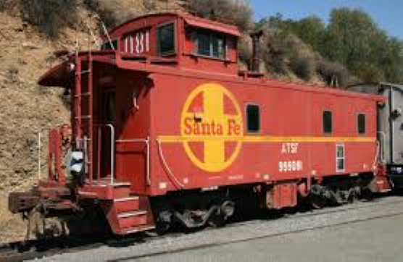
.. -- .. (The End)

