Slide 1
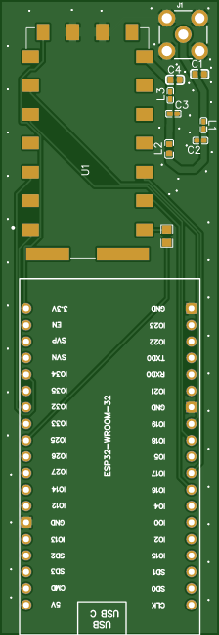
KV4P HT Open-Source Kit
By Chris Wheeler
W4NRG
https://kv4p.com/quick_start.html

Slide 2
What is it?
KV4P HT is an Open-Source Kit designed by KV4P. It is a device that turns your phone, into an Amateur Radio HT that is powered and controlled by the Android device. Using the app “KV4P HT” the Android device provides power, frequency control, and audio.

Slide 3
What does it do?
FM Voice Transmission, Simplex or Repeater with PL Tones
Radio-based APRS Text Messaging (not just location) with built-in 1200 baud modem and Location Beaconing
Scan through unlimited memories and groups
1 watt transmit sips your phone's battery

Slide 4
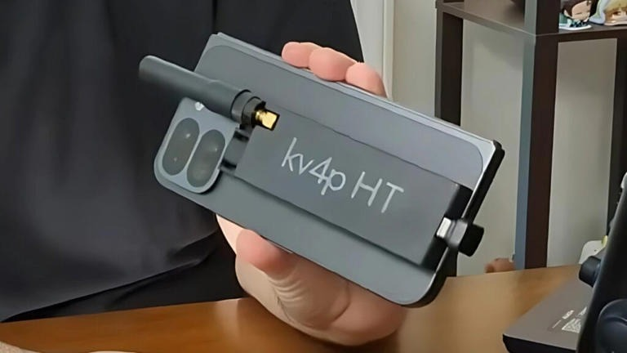
Who can build it?
Anyone!
This kit has only 3 components to solder, The RF chip, SMA Connector, and the Micro-Controller

Slide 5
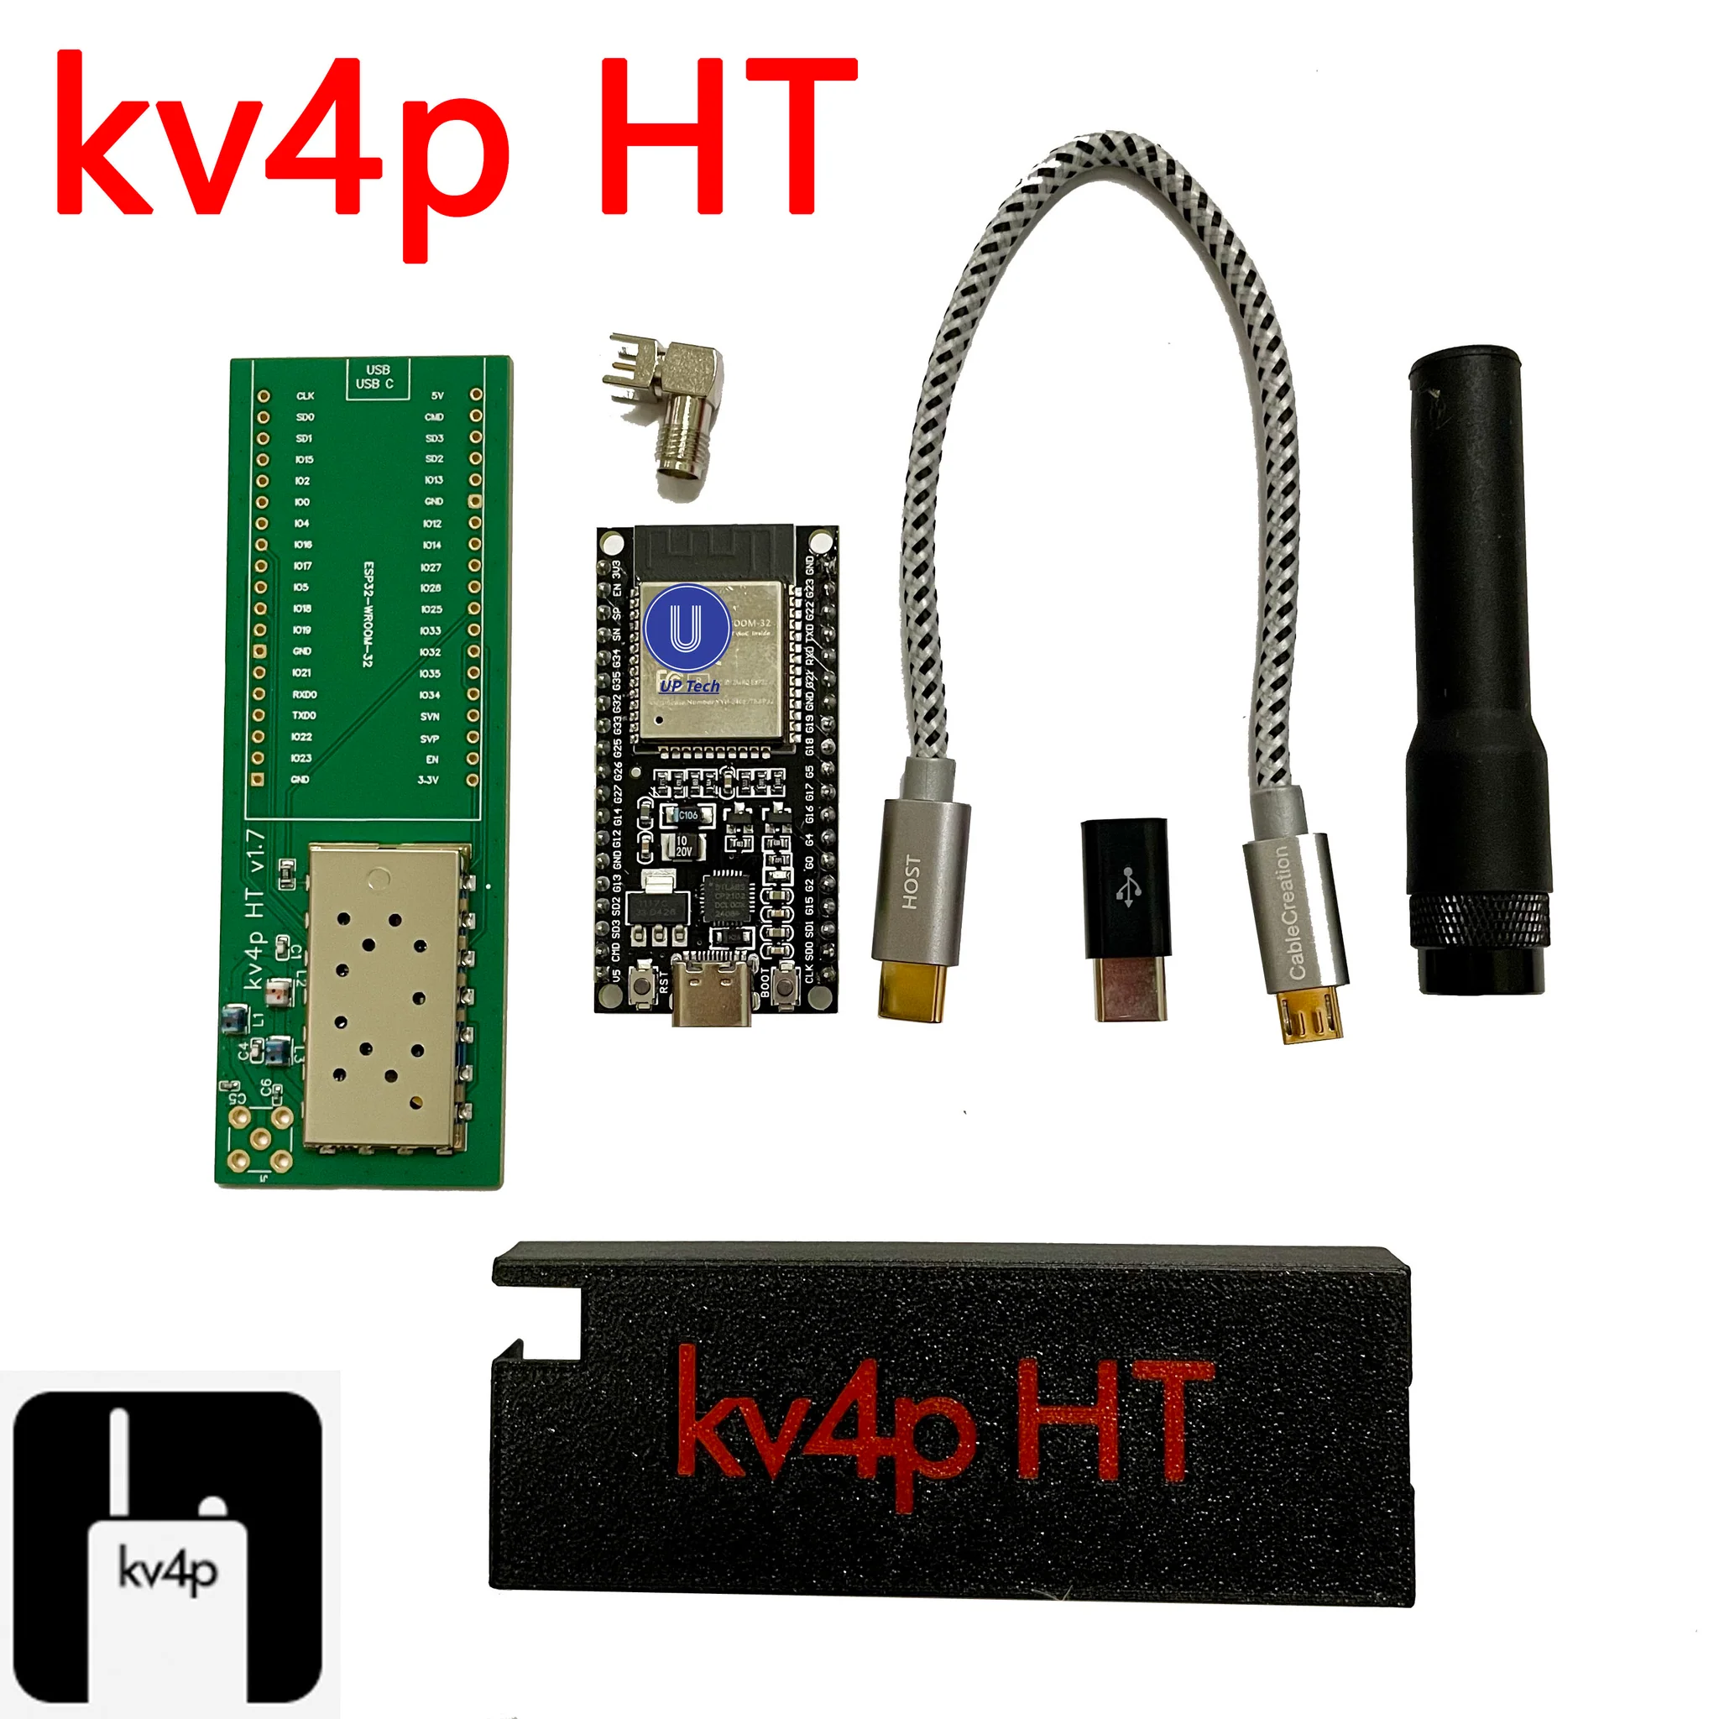
Where do you get it?
KV4P.com has several options
Source the parts and PCB yourself $??
Buy the complete set of parts $39
Buy the complete built kit $59

Slide 6
How to build it
Solder the SA818-V, ESP32, and SMA connector to the PCB.
Then, trim all of the ESP32's legs as short as possible.

Slide 7
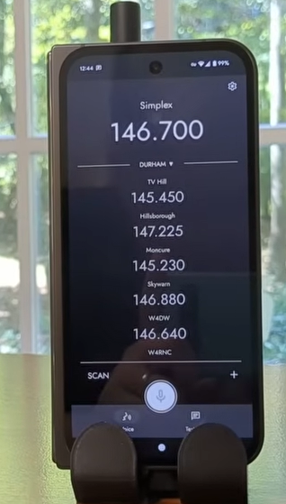
How to use it
Download the “KV4P HT” Android app
Plug in the HT using the USB-C cable
The first time you run the Android app, it will flash the firmware onto your kv4p HT. It takes about 5-10 minutes.
Type in your frequency and PL Tone, then push the PTT button

Slide 8
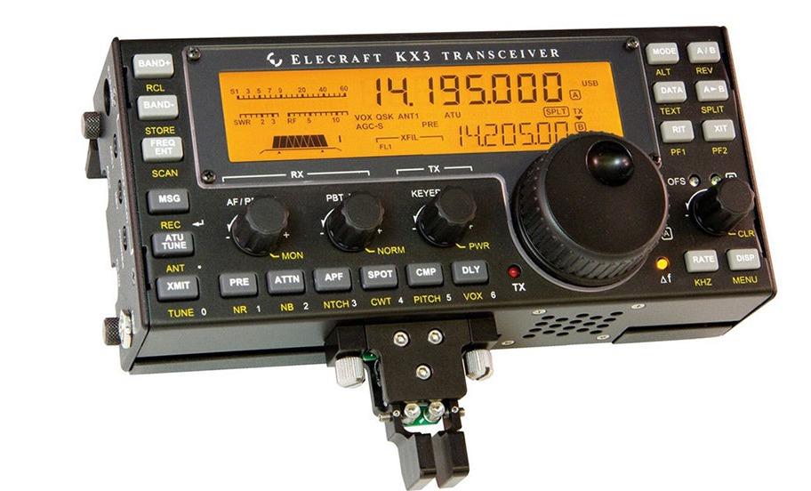
Other Kits
KX3 160-6M TRANSCEIVER $1599
Adjustable 0.1-10 W
Software-defined radio (SDR) architecture
Built-in PSK/TTY decode/encode allows data mode operation without a PC

Slide 9
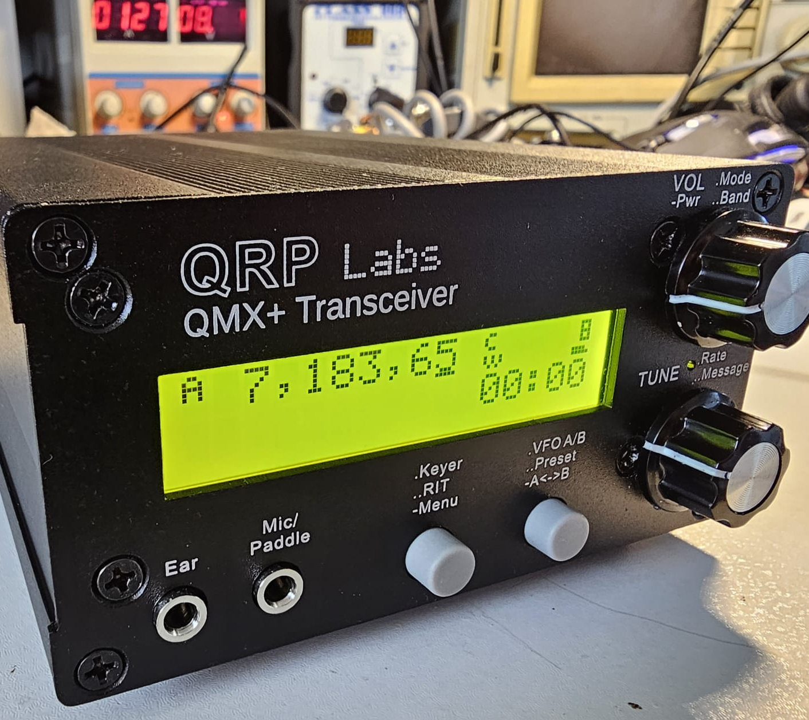
Other Kits
QRP Labs QMX+ 160-6m multi-mode transceiver $125
CW and FSK Digi modes (SSB in future firmware release)
3-5W output at 12V supply

Slide 10
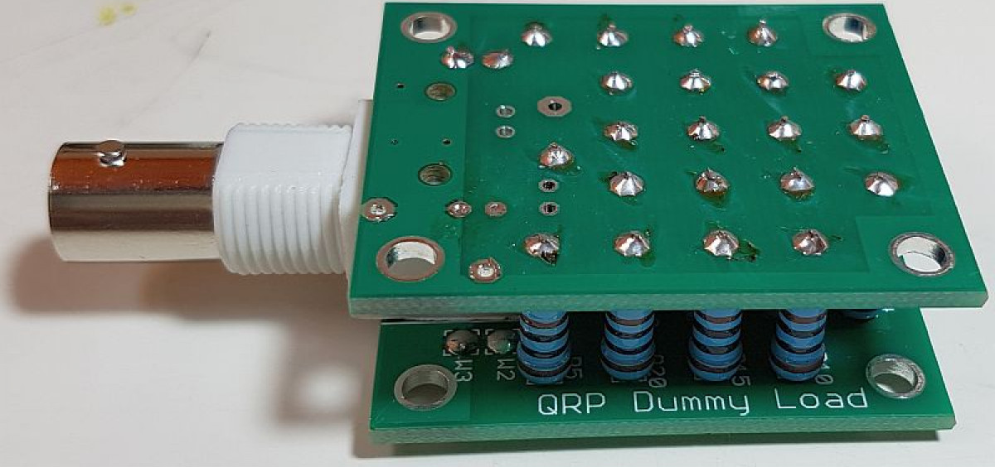
Other Kits
QRP Labs 50-ohm 20W QRP HF Dummy Load $8.50
20 individual 1K resistors in parallel
BNC connector
Two identical PCBs with the resistors sandwiched between them

Slide 11
Other Kits
Four State QRP Group CW-VOX $49
Leverages the ability of Morse Code operators to vocalize Morse Code using "da" for dashes and "dit" for dots
Built-in condenser microphone
Operated either from an internal 9v battery, or an external 9 to 12 volt source

