Slide 1
Understanding
Near Vertical Incidence Skywave
NVIS
Calvert AUXCOMM
March 2026
Info herein taken from Rohde & Schwarz
Application Note

Slide 2
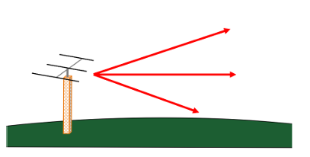
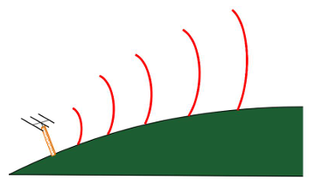
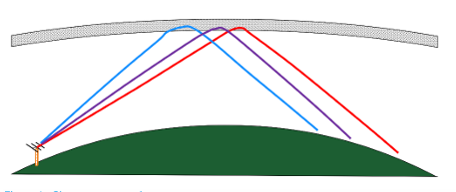
Propagation Modes
Line of Sight
Groundwave
Skywave

Slide 3
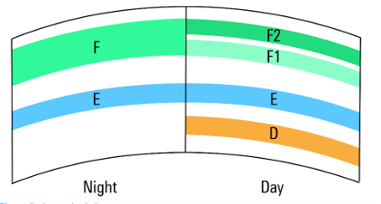
Ionosphere
D-layer, from 60 to 100 km; the E-layer, from 100 to 125 km; and the F-layer, or layers, from about 200 to 275 km.

Slide 4
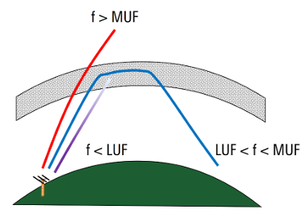
Maximum Usable Frequency (MUF)
If a signal is aimed straight up, once a certain frequency is reached, RF is no longer returned by the ionosphere and instead continue on into space – this is the critical frequency. Critical frequency is a function of both the current ionization level as well as the measurement location:

Slide 5
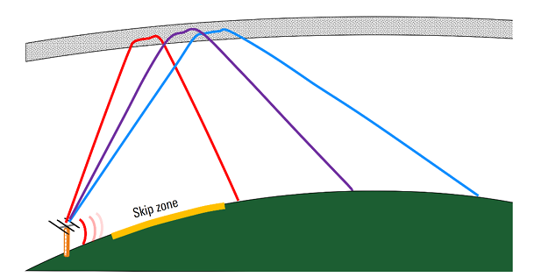
Incidence Angle
One way to provide coverage within a skip zone is the use of higher incidence angle signals, since a very high incident angle causes signal to be returned to Earth closer to the transmitter.

Slide 6
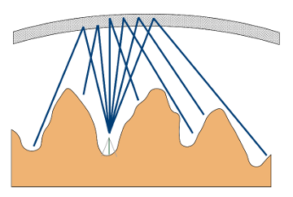
NVIS Communications
NVIS is implemented using an antenna with a very high take-off angle, typically 75° or more, with transmission taking place on lower HF frequencies to ensure that signals are returned from ionosphere. The nearly-vertical take-off angle of these signals cause them to be returned to Earth relatively close to the transmitter. Coverage is often fairly uniform within a radius of up to several hundred kilometers from the transmitter.

Slide 7
Advantages/Disadvantages
Advantages
  More resistant to fading
  Shorter path through the D-layer and therefore less D-layer absorption
  “Line of sight” propagation between the transmitter and the ionosphere as well as between the ionosphere and the receiver(s).
Disadvantages
  NVIS only works at lower frequencies
    Signals with too high of a frequency will simply pass through the F-layer into space
    BUT…NVIS requires the use of frequencies that are high enough to avoid excessive D-layer attenuation. D-layer absorption is higher for lower frequency signals.
    NVIS frequencies range from 4 to 8 MHz during the day and from 2 to 4 MHz at night.

Slide 8
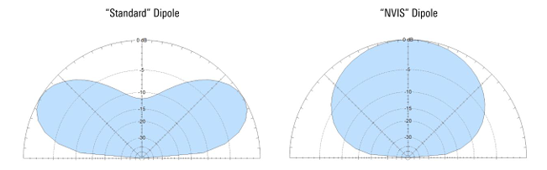
NVIS Antennas

Slide 9
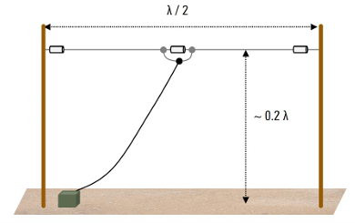
NVIS Dipole

Slide 10
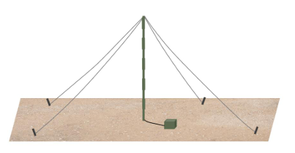
Low Inverted V

Slide 11
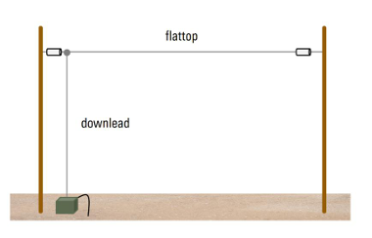
Inverted L
Needs a good ground or a counterpoise

Slide 12

Loop Antennas Including Mag Loops

Slide 13
Calvert AUXCOMM Plans
Participate in “NVIS Day” sponsored by Ohio ARES
  April 25 10 am to 4 pm
  3902 LSB
  7240 LSB
  DMR ARES Talkgroup 31395 (if feasible)
  https://arrl-ohio.org/nvis/
Set up multiple NVIS stations around the county/tri-county area.
  Single op or team
  Use your own callsign
K3CAL will set up outdoors near the PSB EOC
Check local coverage as well as contacts with Ohio stations
Rain date May 2nd (Calvert Only)

Slide 14
Questions

