Slide 1

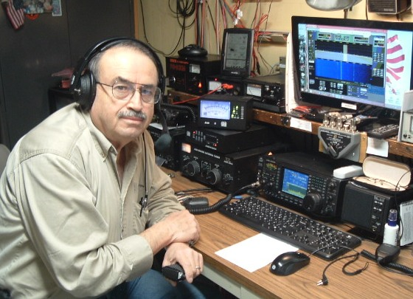
Net Controller Training
If you are interested in learning how to become a Net Control Operator, here’s your chance to learn and practice!
The online class will be held on 20 March at 1900
Student Practice Nets are scheduled on 25 March at 1300 on the 147.315 repeater
To register for the class/net please send an email to bryan.a.pettigrew@gmail.com by 18 March for an accurate headcount
Looking for a few “Elmer” hams for the practice nets on the 25th to help out as well!

