Slide 1
How to Create a VDEM Account in the Commonwealth of Virginia Learning Center
Date: July 13, 2021

Slide 2
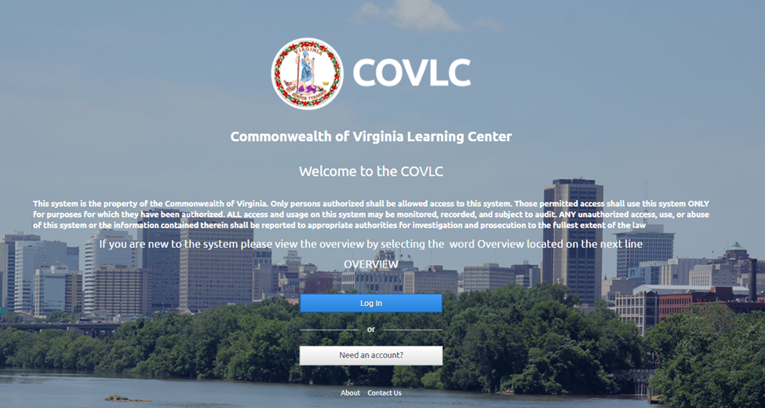
To create a VDEM account in the Commonwealth of Virginia Learning Center, visit: https://covlc.virginia.gov and click on “Need an Account?”
*If this button is overlayed with “Contact Us”, please use a different browser.

Slide 3
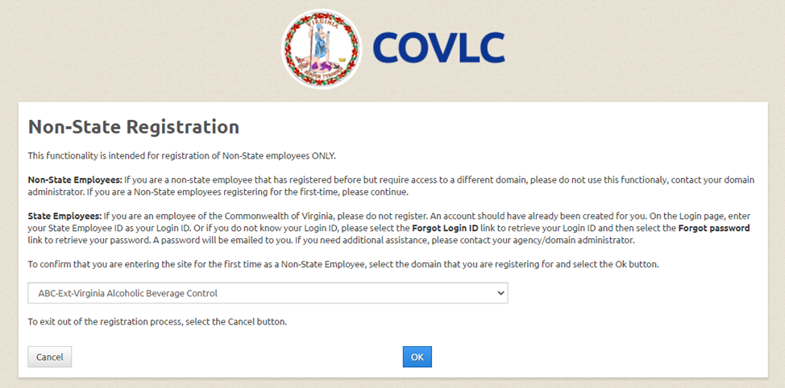
IMPORTANT – The non state registration enables non-state employees to access the VLC and take courses. If you are an employee of a State agency you most likely already have an account and should contact the VDEM help desk to gain access to VDEM's domain. If you do not have a VLC account and desire to take a VDEM course, you must choose VDEM as your organization to proceed. Please DO NOT select your domain, as we cannot approve any accounts that are outside of VDEM.
You must select VDEM’s domain on this page by clicking on the drop down arrow and scrolling down (see next step).

Slide 4
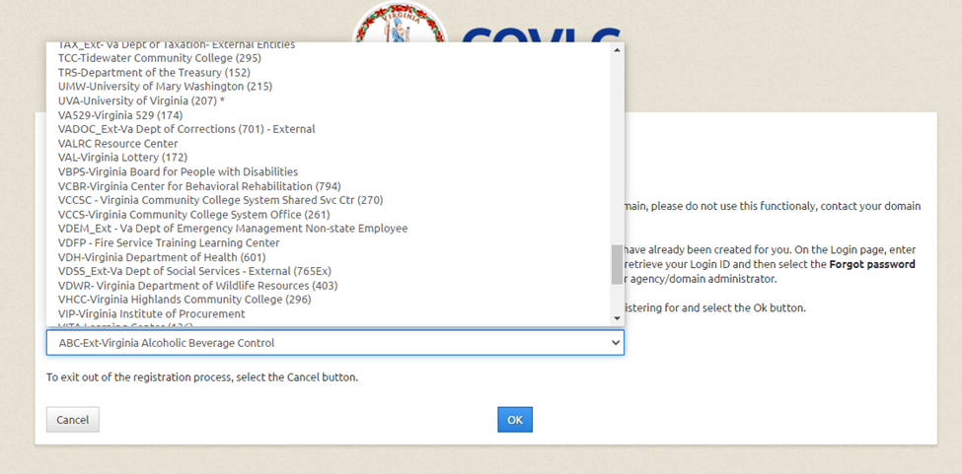

IMPORTANT – You must select the correct domain to proceed! Please DO NOT select your domain, as we cannot approve any accounts that are outside of VDEM.
Choose VDEM_Ext – Va Dept of Emergency Management Non-state Employee here and click “Ok”.

Slide 5
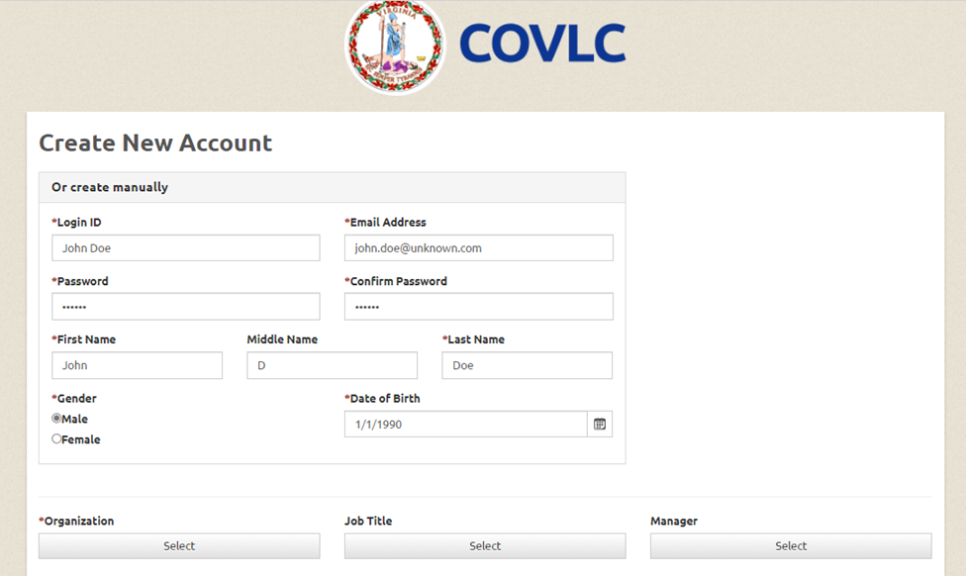
You only need to fill in the fields with an asterisk here. Once you have an account, you are able to change your information if you’d like. It helps us if you include a middle initial.

Slide 6
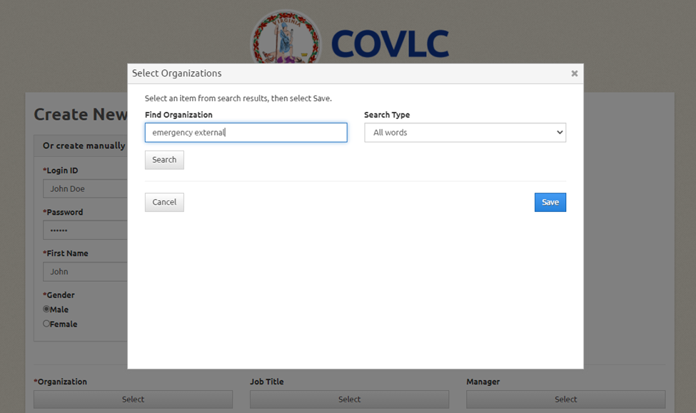
You will be using VDEM as your organization for this account. Please type in the box “emergency external” and click “Search”.

Slide 7
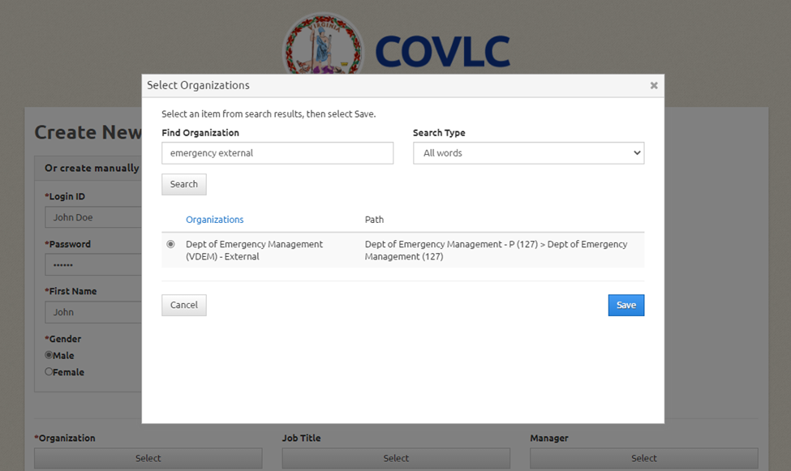
Dept. of Emergency Management (VDEM) – External should populate. Click on the radio button and then click “Save”.

Slide 8
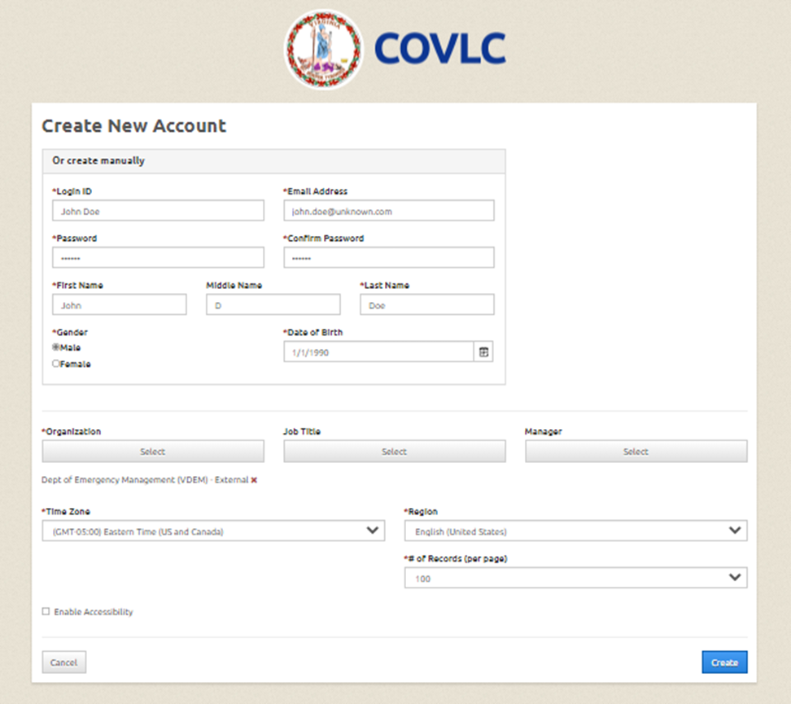

Once you have completed the fields necessary, click “Create” to submit your request. It may take up to 72 hours for your account to be approved.
**If it says your email is already in the system, you may have an account, and you should not attempt to create a new one. Please contact us if you receive this message.

Slide 9
Registering for Training:
Once you are logged in, your home page is your Training Home. On this page you will find things such as Upcoming Learning, Completed Training, Announcements, etc.
On the right side, you will see a Search text box.
Type in the course title or number (i.e. ics 300, g290, hseep). It is helpful to keep it on All Words and click Search.
A list of related courses should populate.
Click the desired course title/link.
The next page you will find a course synopsis. Below that you will see sections by date and location. There should be an enroll tab directly next to each section.

Slide 10
Helpful Information:
If you think you have an account with VDEM but forgot your login information, email our Help Desk at lmshelp@vdem.virginia.gov.
If you know your Login ID, but forgot your password, you can try the “Forgot Password” tab. The system will email you a temporary password. If you do not get an email, please check your spam folder. If there is not an email there, your account may be inactive or you may have an old or incorrect email listed in the system. Please send us an email, and we will try to help.
If you search for a training and cannot find it, you may not have access to view it. Please contact us if this issue comes up.

